Slide 1

Review about recent papers of
Nystrom method
汇报人：王思为

Slide 2
01
研究趋势
02
基本概念
Research Background
Basic Conception
目录
03
算法方向
04
实际应用
CONTENTS
Theoretical Research
Practical Application
05
未来展望
Future Prospect

Slide 3
PART
ONE
研究
趋势

Slide 4
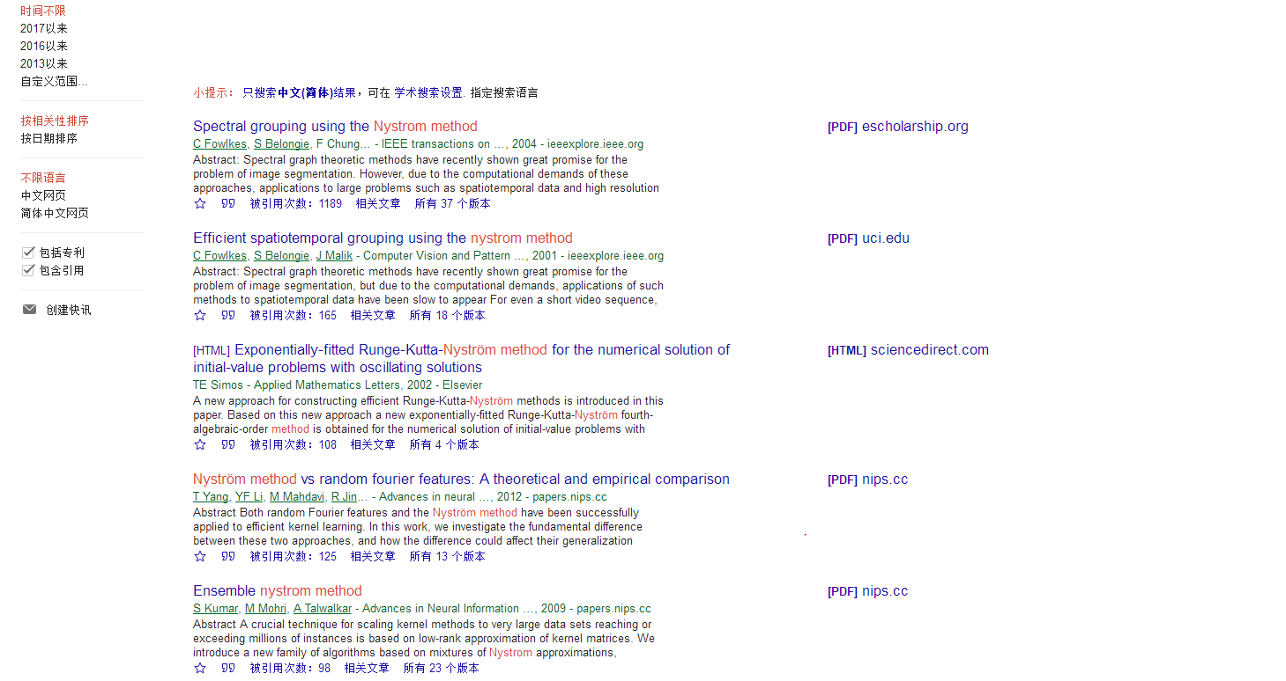
研究趋势

Slide 5
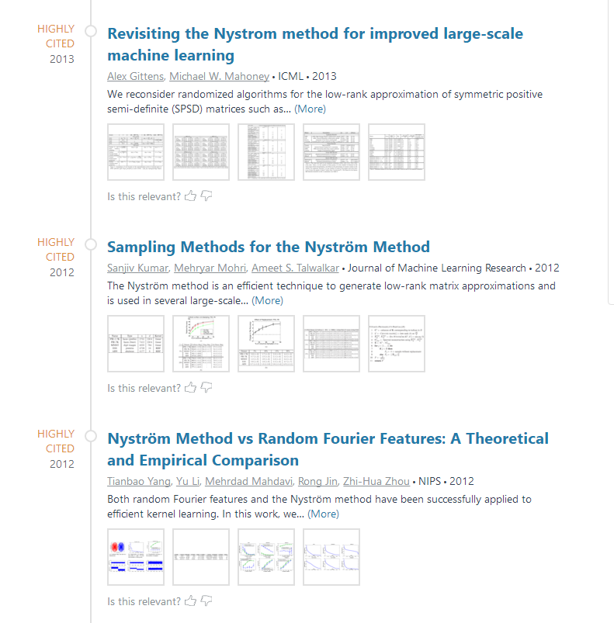
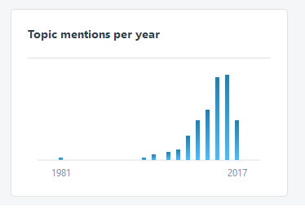

Slide 6
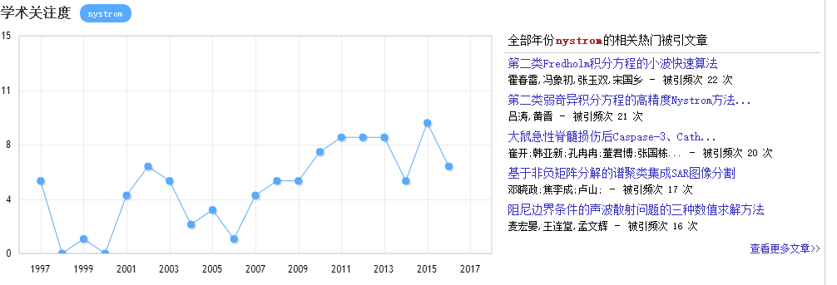

Slide 7
PART
TWO
基本
概念

Slide 8
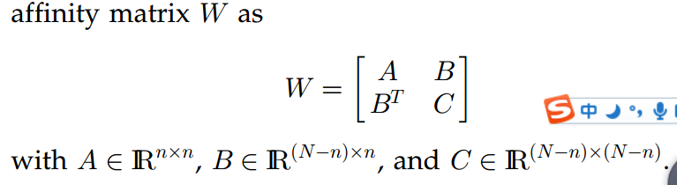
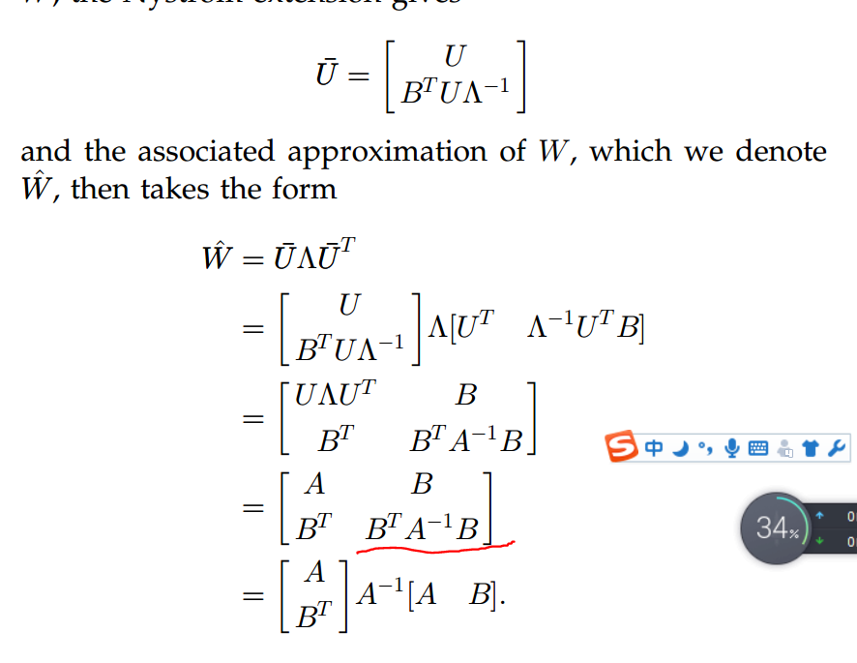
THE NYSTROM method
从N*N的原始矩阵中选取n列（即n个landmarks），近似计算
用红线处的矩阵逼近大矩阵C，从而减少计算复杂度由于 n<<N,所以抽样后剩余点的数目通常是很大的,经过Nyström 逼近,避免了使用剩余点的相似度,从而极大地降低了问题求解的空间和时间复杂度.

Slide 9
improvements：
如何选取的合适的n
在现有大数据的数据集上，即使只取部分样本，待计算矩阵w仍然很大；同时为了提升逼近的效果，n的取值应该尽可能大；但是为了提高计算效率，n又应该尽可能的小

Slide 10
PART
THREE
算法方向

Slide 11
理论研究
The key point is that how to choose the appropriate columns or landmarks.
Pre-processing
Reduce the data size
Two strategies
Eigen-decomposition
Low-rank approximation
Nystrom method

Slide 12
Spectral clustering performed on each cluster
k-means-based approximate spectral clustering
(KASP)[1]
Pre-processing
Perform k-means on a large number p
Committees-based Spectral Clustering
(CSC)[2]
Remove near neighborhoods and cluster on the remaining data
[1]Yan D, Huang L, Jordan M I. Fast approximate spectral clustering[C]// ACM SIGKDD International Conference on Knowledge Discovery and Data Mining. ACM, 2009:907-916.
[2] Shinnou, H., & Sasaki, M. (2008). Spectral Clustering for a Large Data Set by Reducing the Similarity Matrix Size. International Conference on Language Resources and Evaluation, Lrec 2008, 26 May - 1 June 2008, Marrakech, Morocco (Vol.24, pp.201-204). DBLP.

Slide 13
理论研究
Nystrom方法
((Fowlkes et al. 2004) applied the Nystrom method to accelerate the eigen-decomposition. Given an n×n matrix, Nystrom method computes the eigen- vectors of a p × p sub-matrix (randomly sampled from the original matrix).
Fixed Sampling
Uniform Sampling performs the best
Columns distribution
Adaptive Sampling
Equal weight
Ensemble Sampling
Exponential weight
Weight regularization
best
Kumar, Sanjiv, Mohri, Mehryar, and Talwalkar, Ameet. Sampling methods for the Nystrom method. ¨ Journal of Machine Learning Research, 2012.

Slide 14
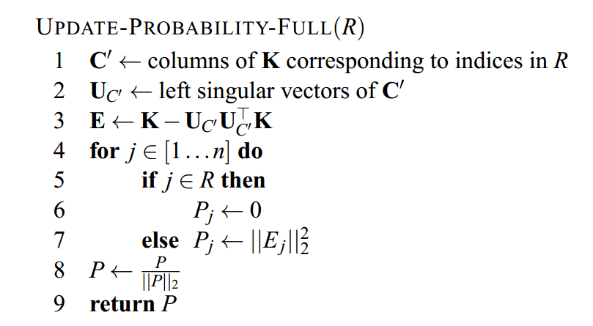
Adaptive Method
01
Formula representation
02
The way to update distribution
Kumar, Sanjiv, Mohri, Mehryar, and Talwalkar, Ameet. Sampling methods for the Nystrom method. ¨ Journal of Machine Learning Research, 2012.

Slide 15
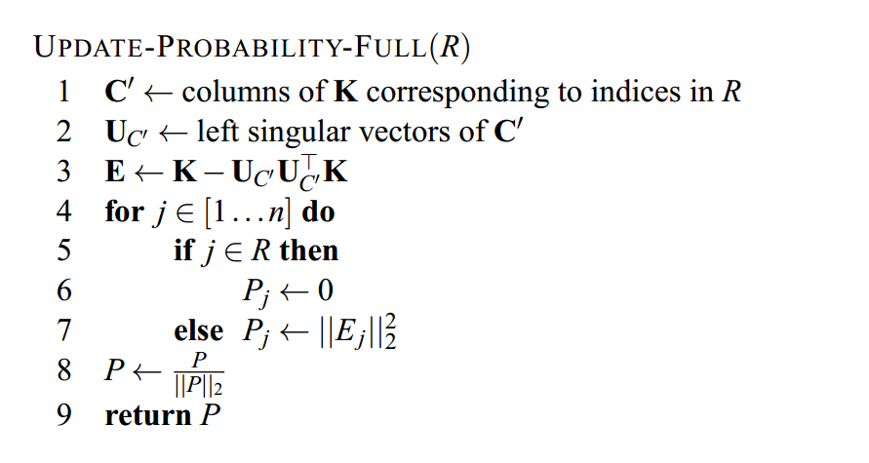

Slide 16
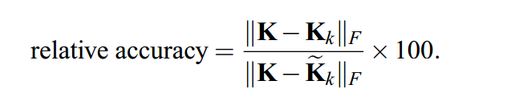
we measured the accuracy of reconstruction relative to the optimal rank-k approximation, as

Slide 17
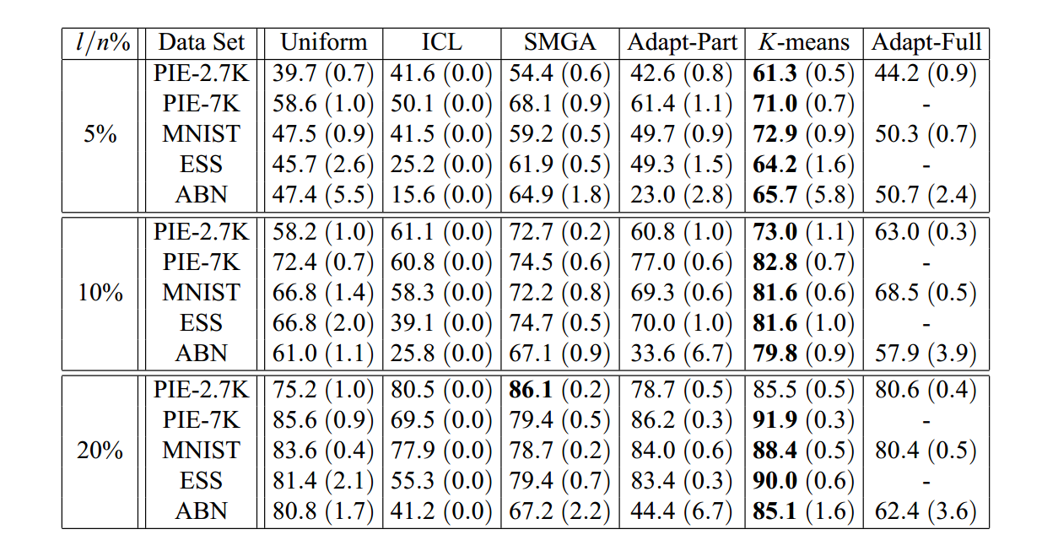

Slide 18
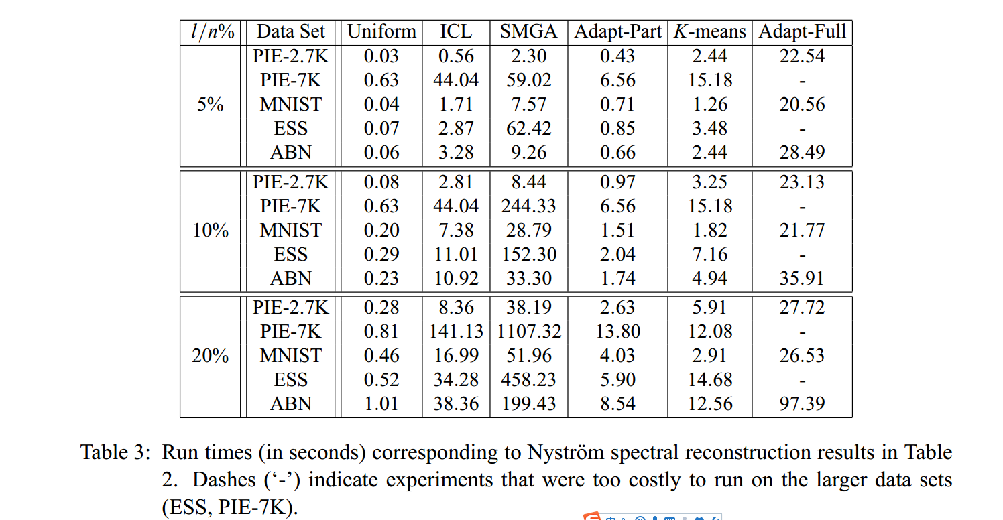

Slide 19
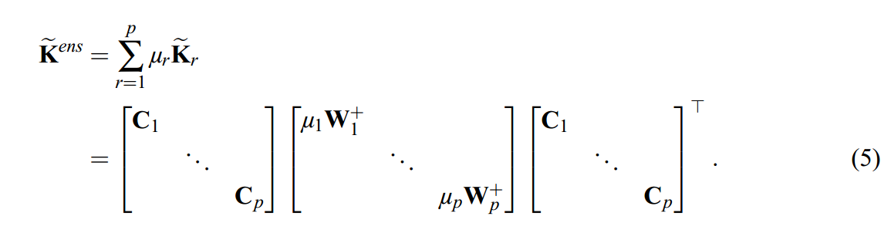
Ensemble Method
01
Formula representation
02
The way to choose weight
Equally weighted, exponential weighted and learning weighted
Chen, X., & Cai, D. (2011). Large scale spectral clustering with landmark-based representation. AAAI Conference on Artificial Intelligence (pp.313-318). AAAI Press.

Slide 20
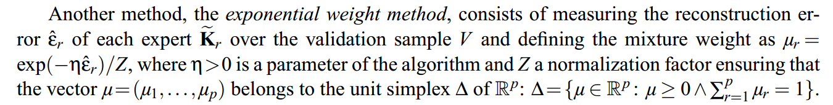
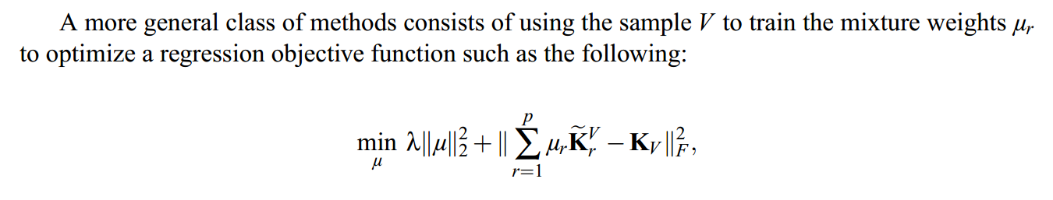

Slide 21
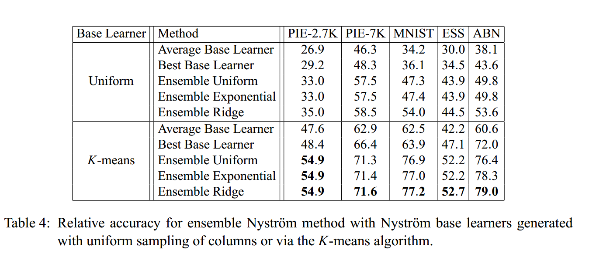

Slide 22
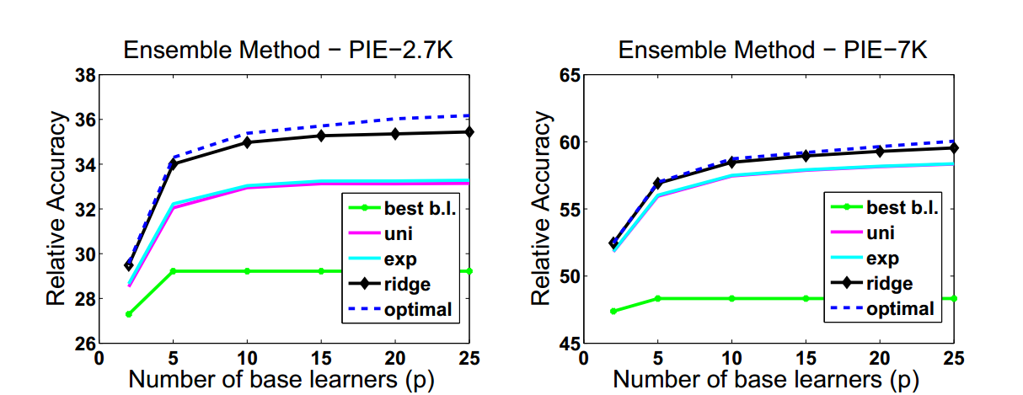
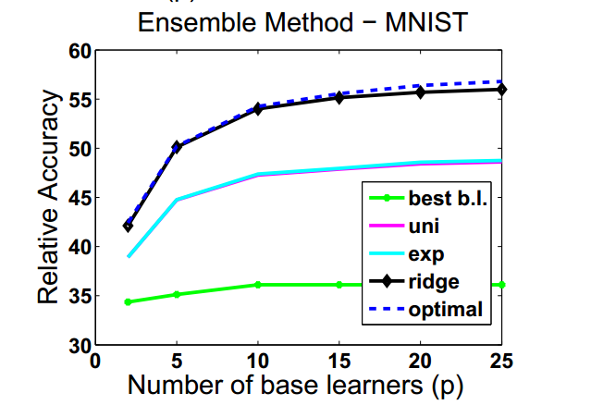
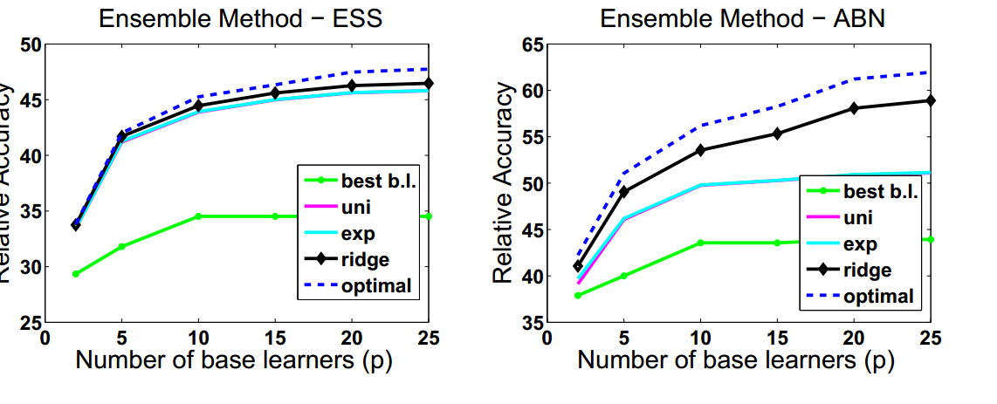

Slide 23
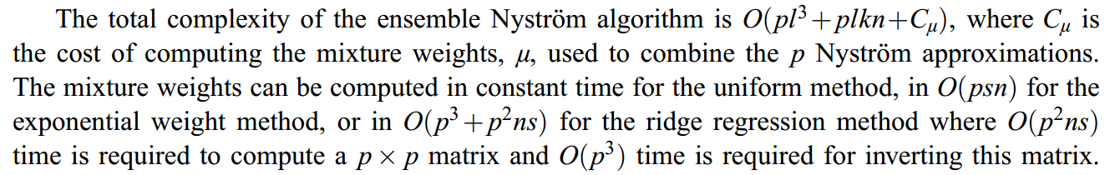

Slide 24
PART
FIVE
Landmark selection

Slide 25
Landmark selection
01
Transformed representation
The basic way is to selects p representative data points as the landmarks and represent the remaining data points as the linear combinations of these landmarks(sparse coding)
02
The way to choose landmarks
Random ,the k-means centroids, k-means ++,greedy methods, subspaces
Chen, X., & Cai, D. (2011). Large scale spectral clustering with landmark-based representation. AAAI Conference on Artificial Intelligence (pp.313-318). AAAI Press.

Slide 26
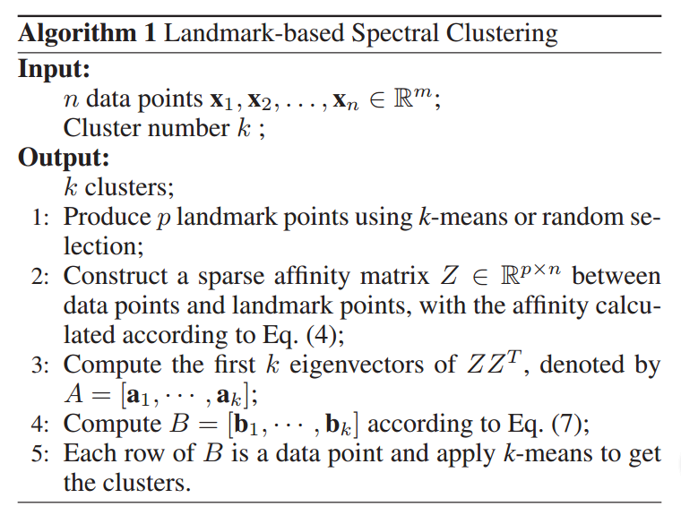
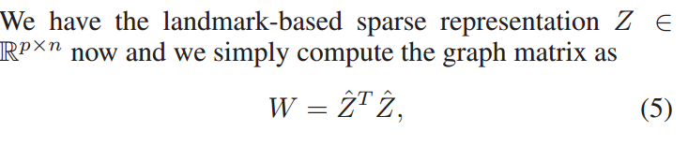
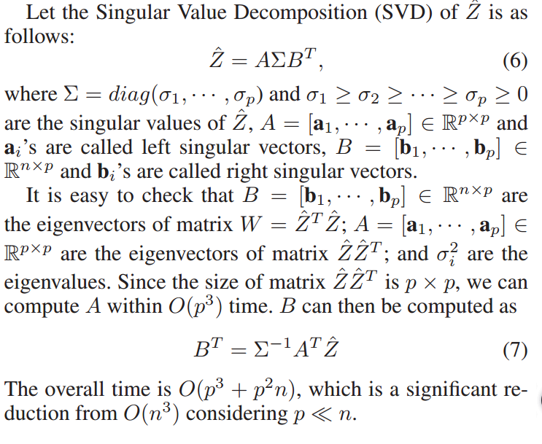

Slide 27
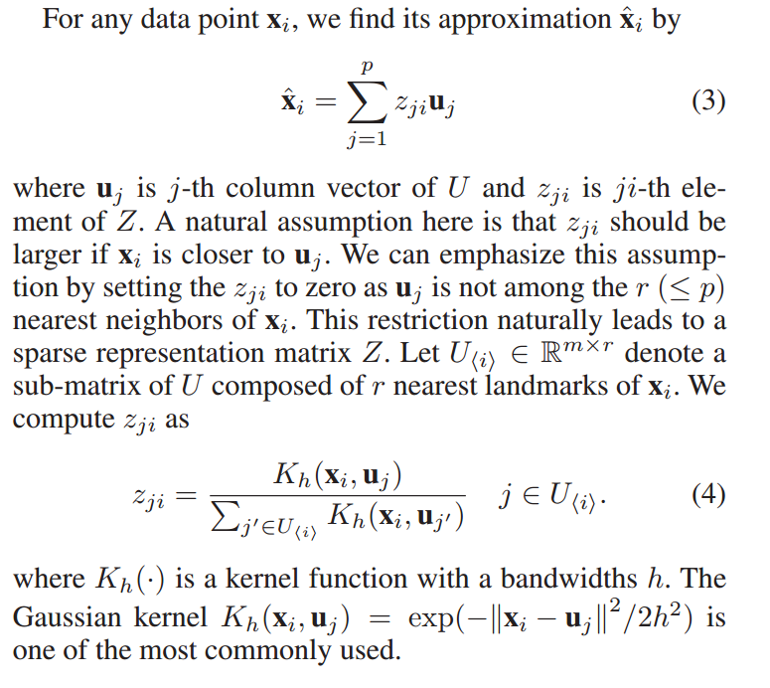

Slide 28
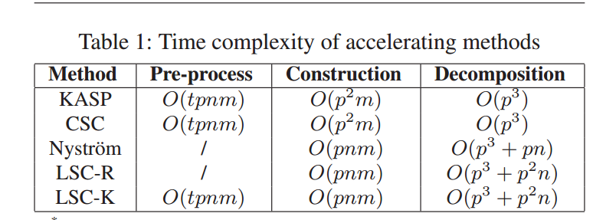

Slide 29
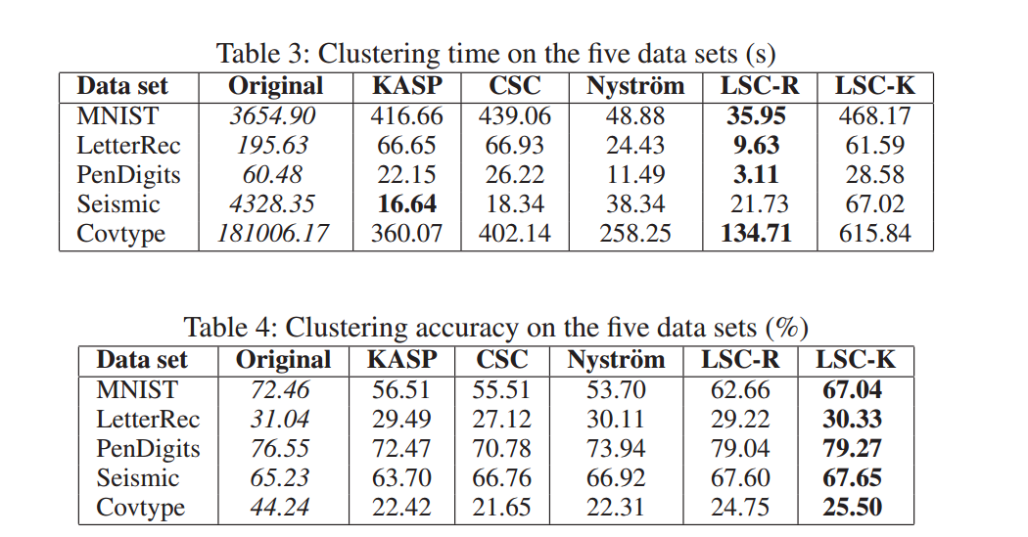

Slide 30
PART
FIVE
未来期望

Slide 31
Future work
01
Sparse coding
The basic way is to selects p representative data points as the landmarks and represent the remaining data points as the linear combinations of these landmarks(sparse coding)
02
The way to choose landmarks
Random ,the k-means centroids, k-means ++,greedy methods, subspaces
Chen, X., & Cai, D. (2011). Large scale spectral clustering with landmark-based representation. AAAI Conference on Artificial Intelligence (pp.313-318). AAAI Press.

Slide 33
References
[1]Chen, X., & Cai, D. (2011). Large scale spectral clustering with landmark-based representation. AAAI Conference on Artificial Intelligence (pp.313-318). AAAI Press.
[2] Kumar, Sanjiv, Mohri, Mehryar, and Talwalkar, Ameet. Sampling methods for the Nystrom method. ¨ Journal of Machine Learning Research, 2012.
[3]Yan D, Huang L, Jordan M I. Fast approximate spectral clustering[C]// ACM SIGKDD International Conference on Knowledge Discovery and Data Mining. ACM, 2009:907-916.
[4] Shinnou, H., & Sasaki, M. (2008). Spectral Clustering for a Large Data Set by Reducing the Similarity Matrix Size. International Conference on Language Resources and Evaluation, Lrec 2008, 26 May - 1 June 2008, Marrakech, Morocco (Vol.24, pp.201-204). DBLP.
[5] Fowlkes, C.; Belongie, S.; Chung, F.; and Malik, J. 2004. Spectral grouping using the nystrom method. ¨ IEEE Transactions on Pattern Analysis and Machine Intelligence 26:2004.
[6] Kumar, S.; Mohri, M.; and Talwalkar, A. 2009. On samplingbased approximate spectral decomposition. In Proceedings of the 26th International Conference on Machine Learning (ICML’09).
[7] D Oglic，T Gaertner; Nyström method with Kernel K-means++ samples as landmarks;PMLR 2017
[8] Li, Chengtao, Jegelka, Stefanie, and Sra, Suvrit. Fast DPP sampling for Nystrom with application to kernel methods. In ¨Proceedings of the 33rd International Conference on Machine Learning, 2016.

Slide 34
THANKS

